Slide 1
What are successful skin care products?
Predicting pricing and popularity of skin care products via linear regression
Crystal Han

Slide 2
Introduction
How will skincare products rise based on several features?
How will do skincare products fare in the current market and future market?
Makeup is included within skincare products

Slide 3
Methodology
Data
Sephora skin care products data via web scraping with Selenium
1000+ data points collected
Tools:
Python, Pandas, Numpy,
Matplotlib, seaborn, BeautifulSoup
Selenium, Statsmodels, scikit-learn
Features:
Continuous: Reviews, Number of Reviews, Number of Likes
Categorical: Skin type, ingredients, brand, products

Slide 4
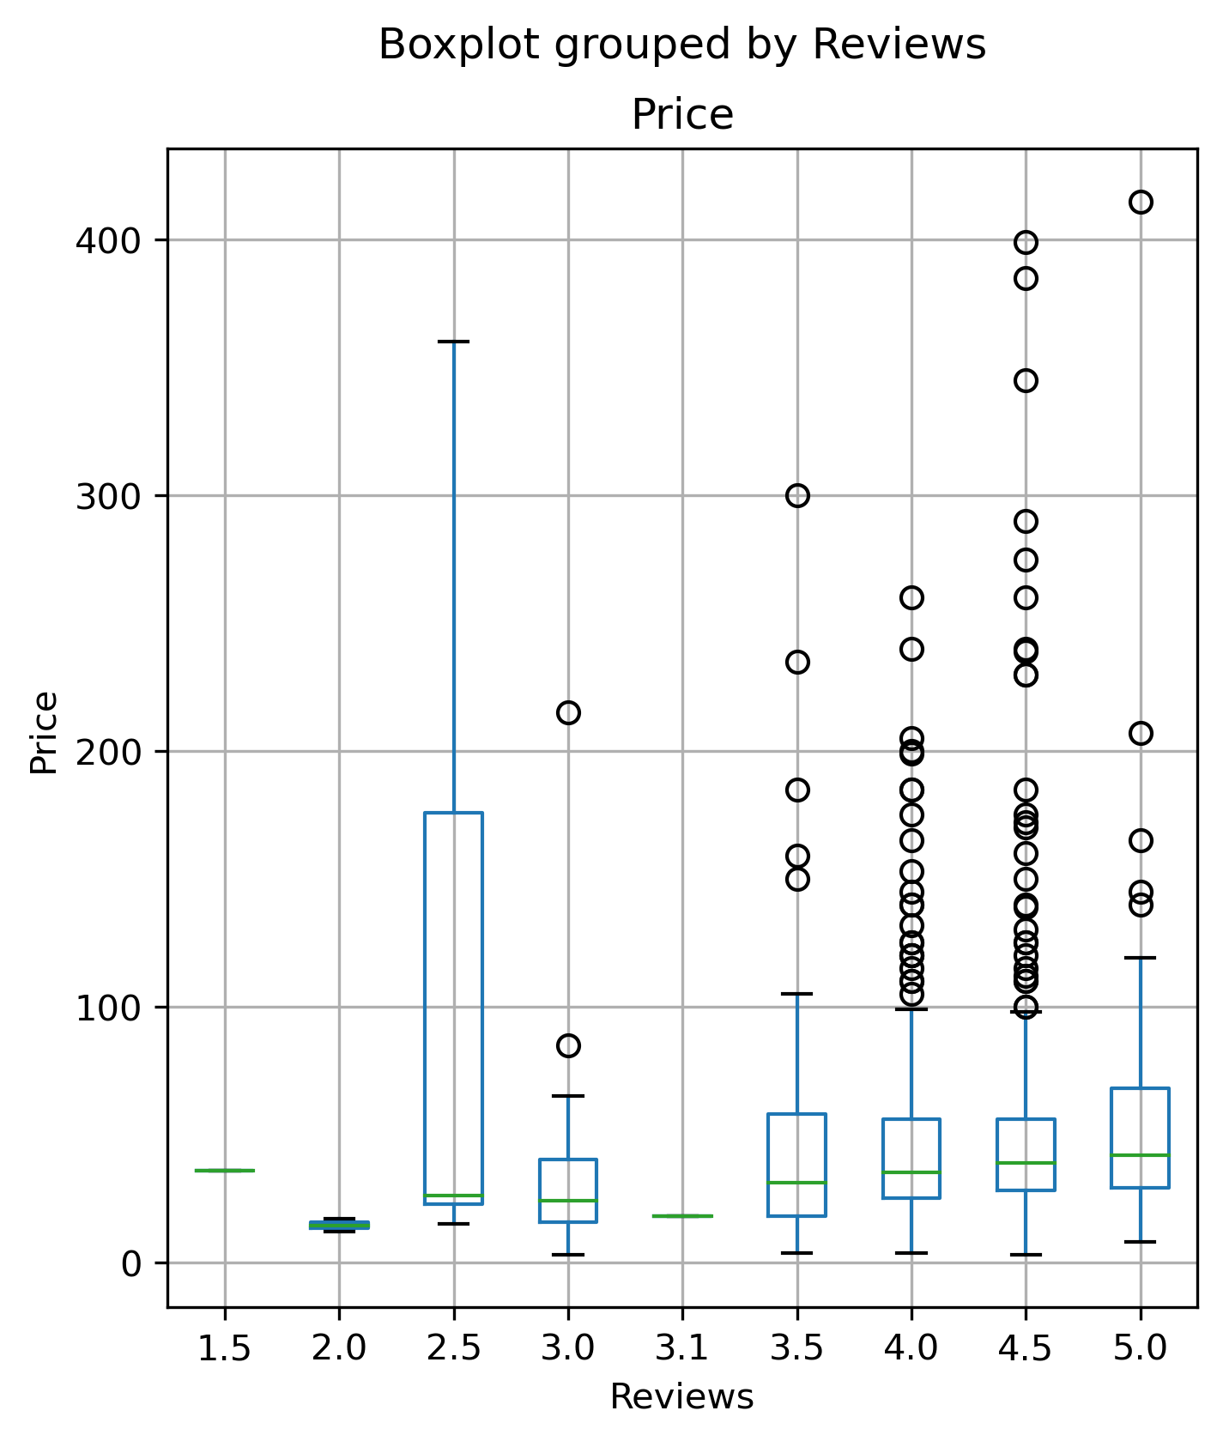
Reviews vs Price

Slide 5
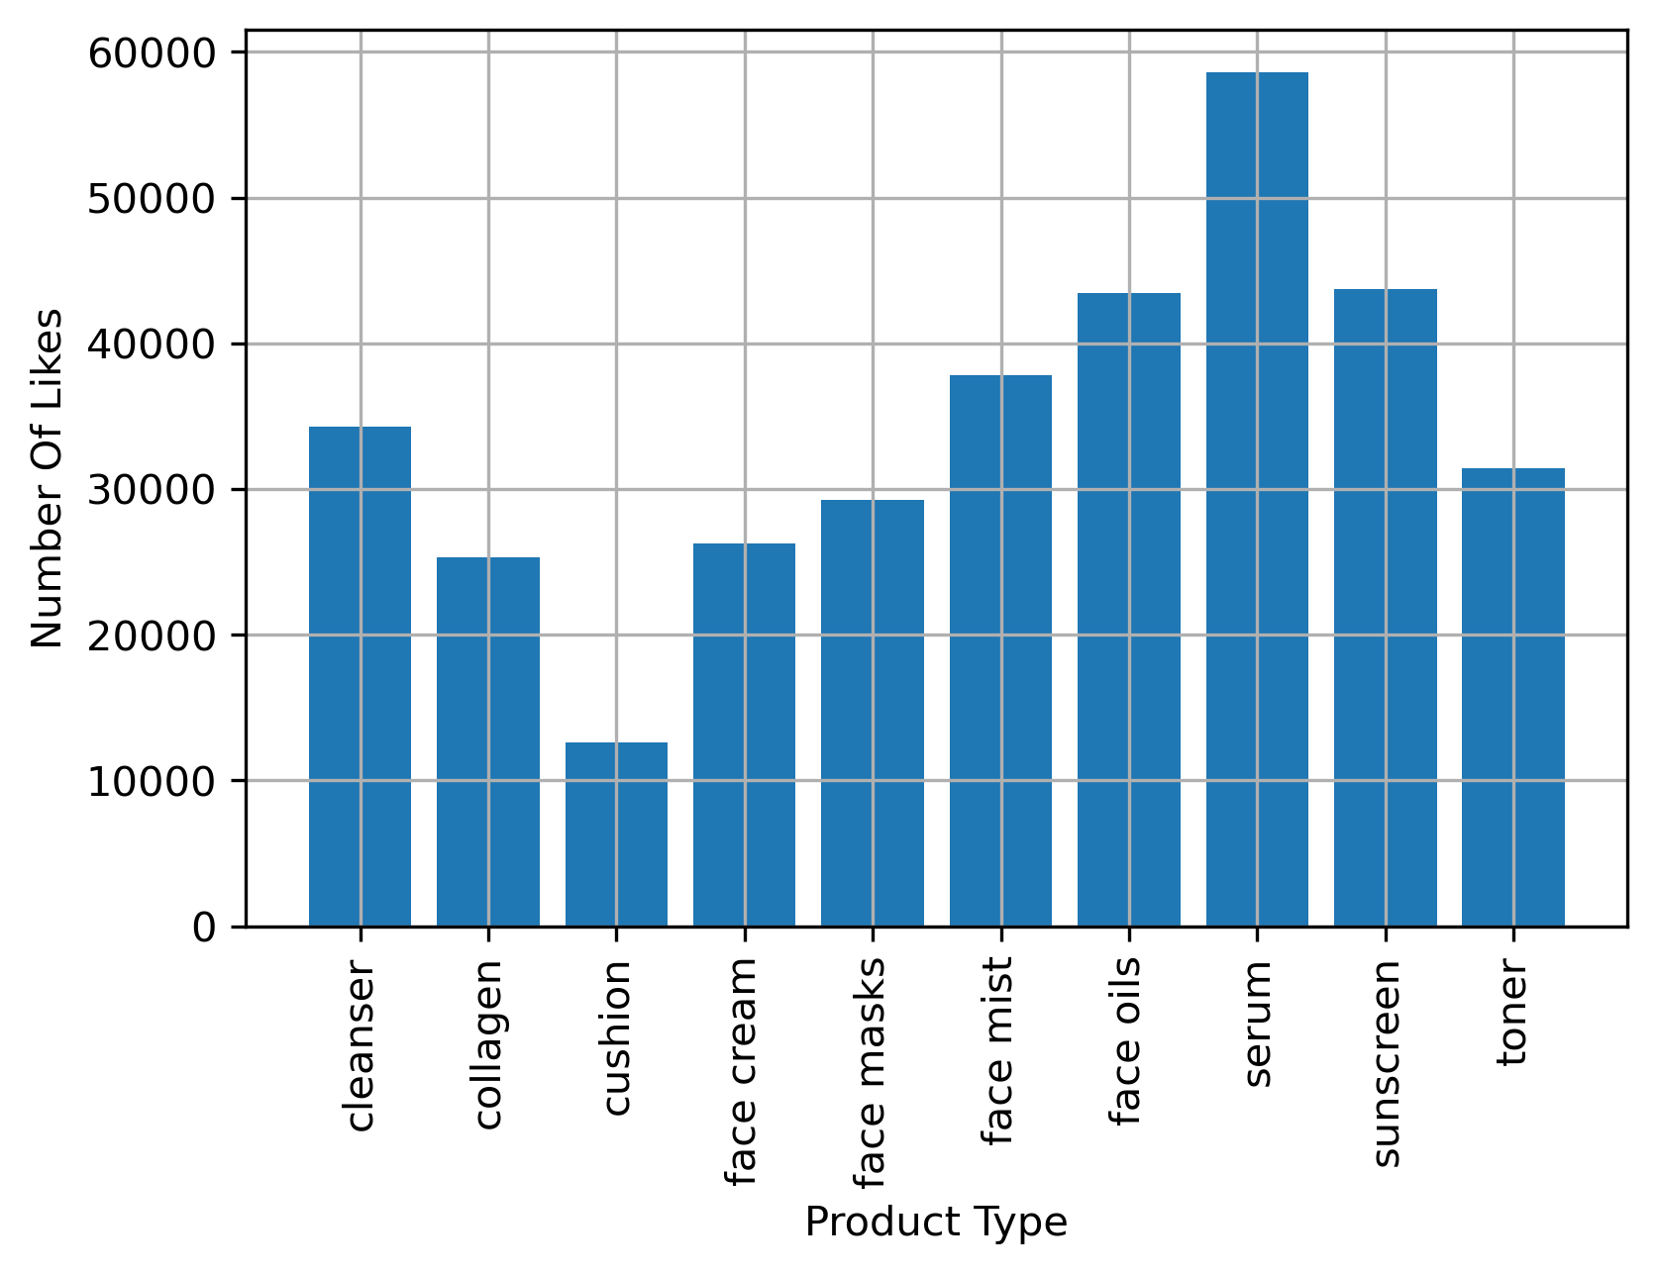
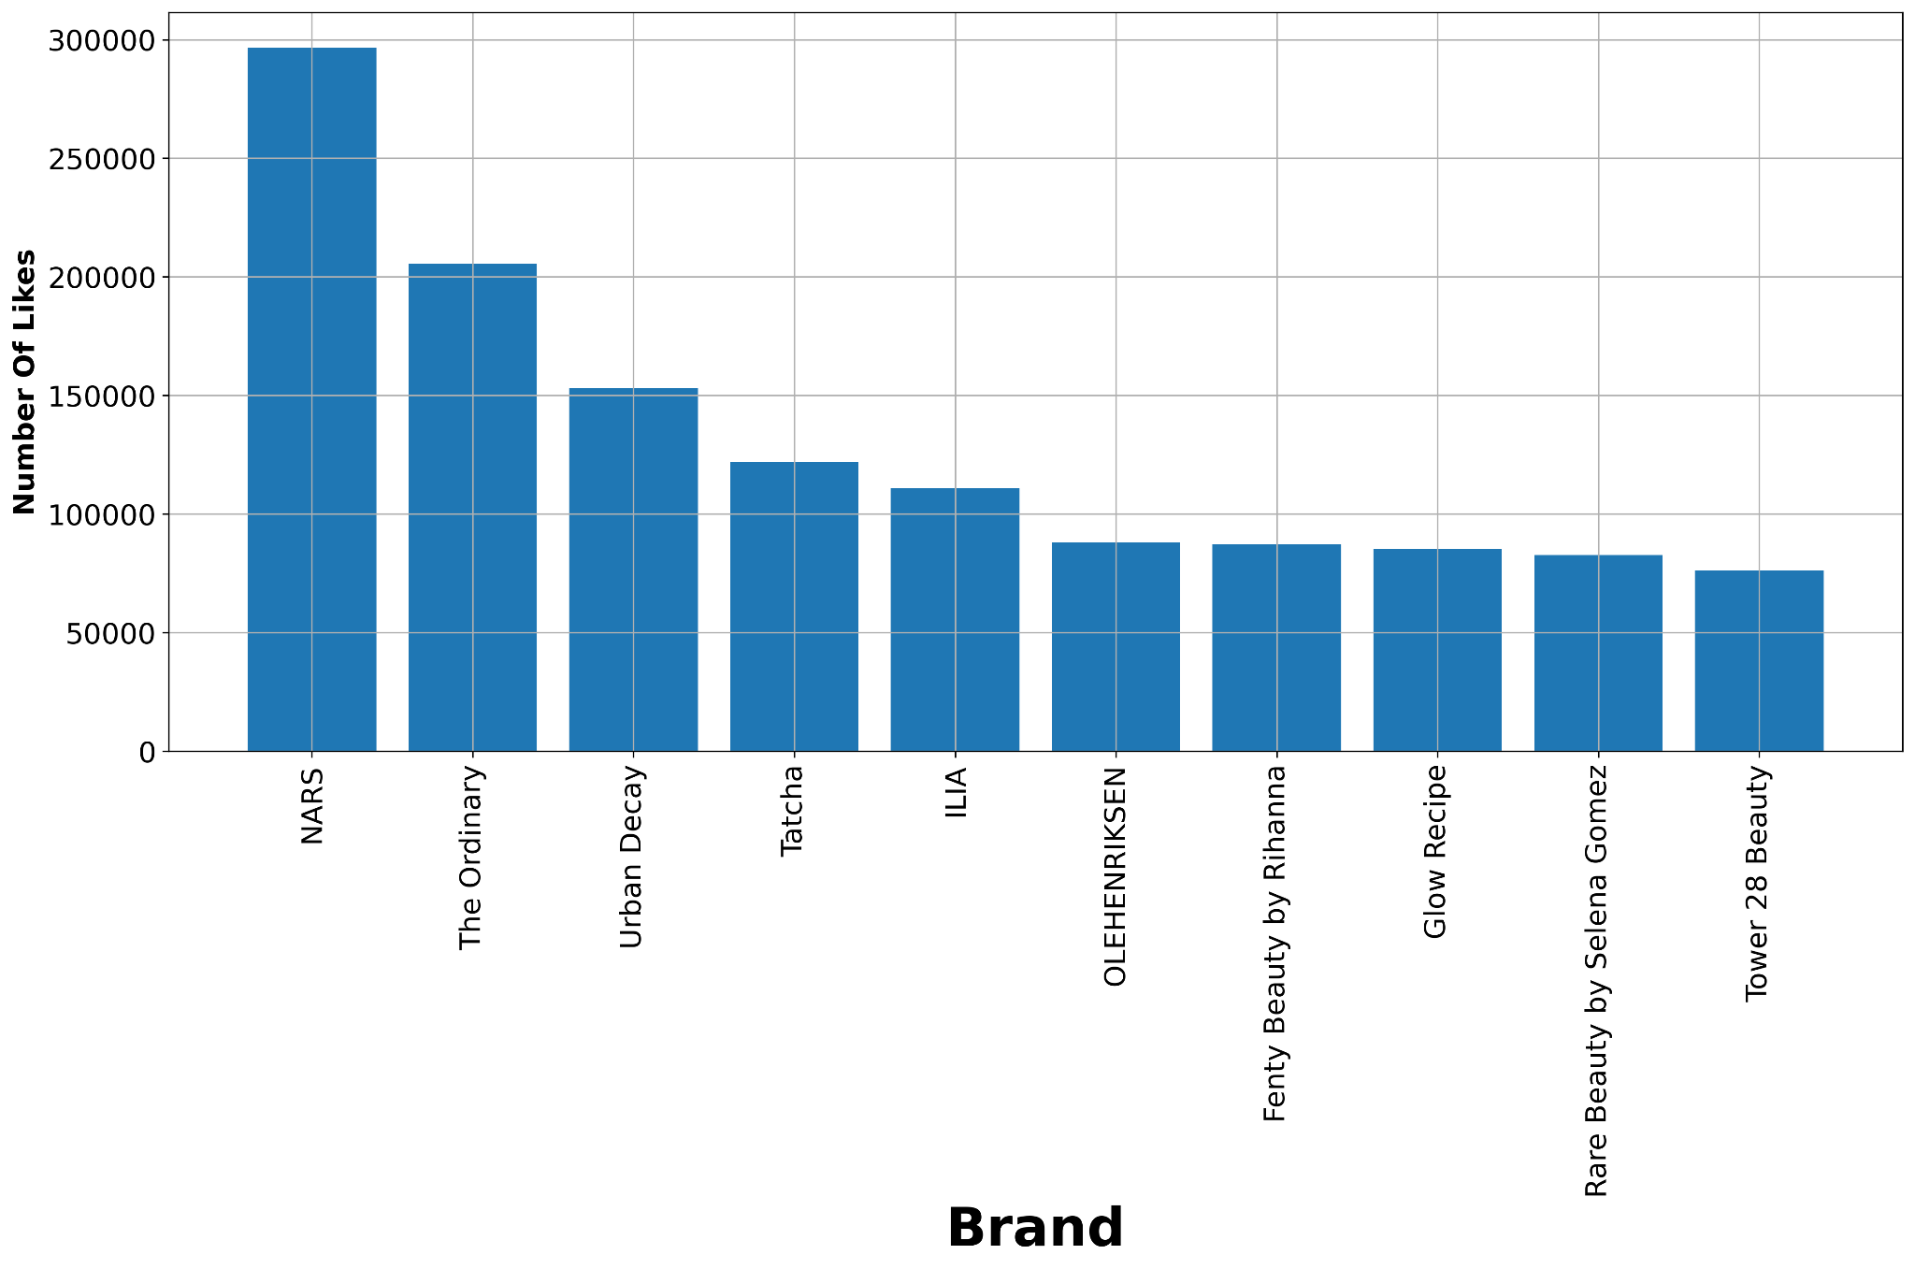
Number of Like against Brand and Product Type

Slide 6
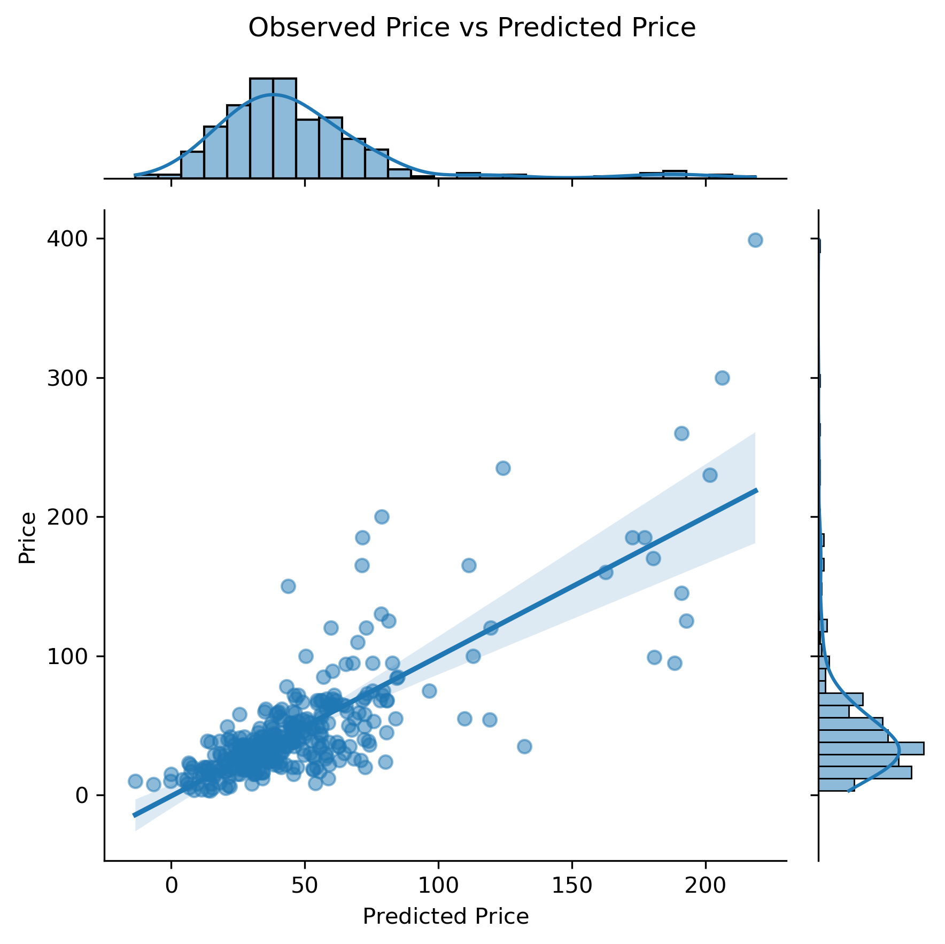
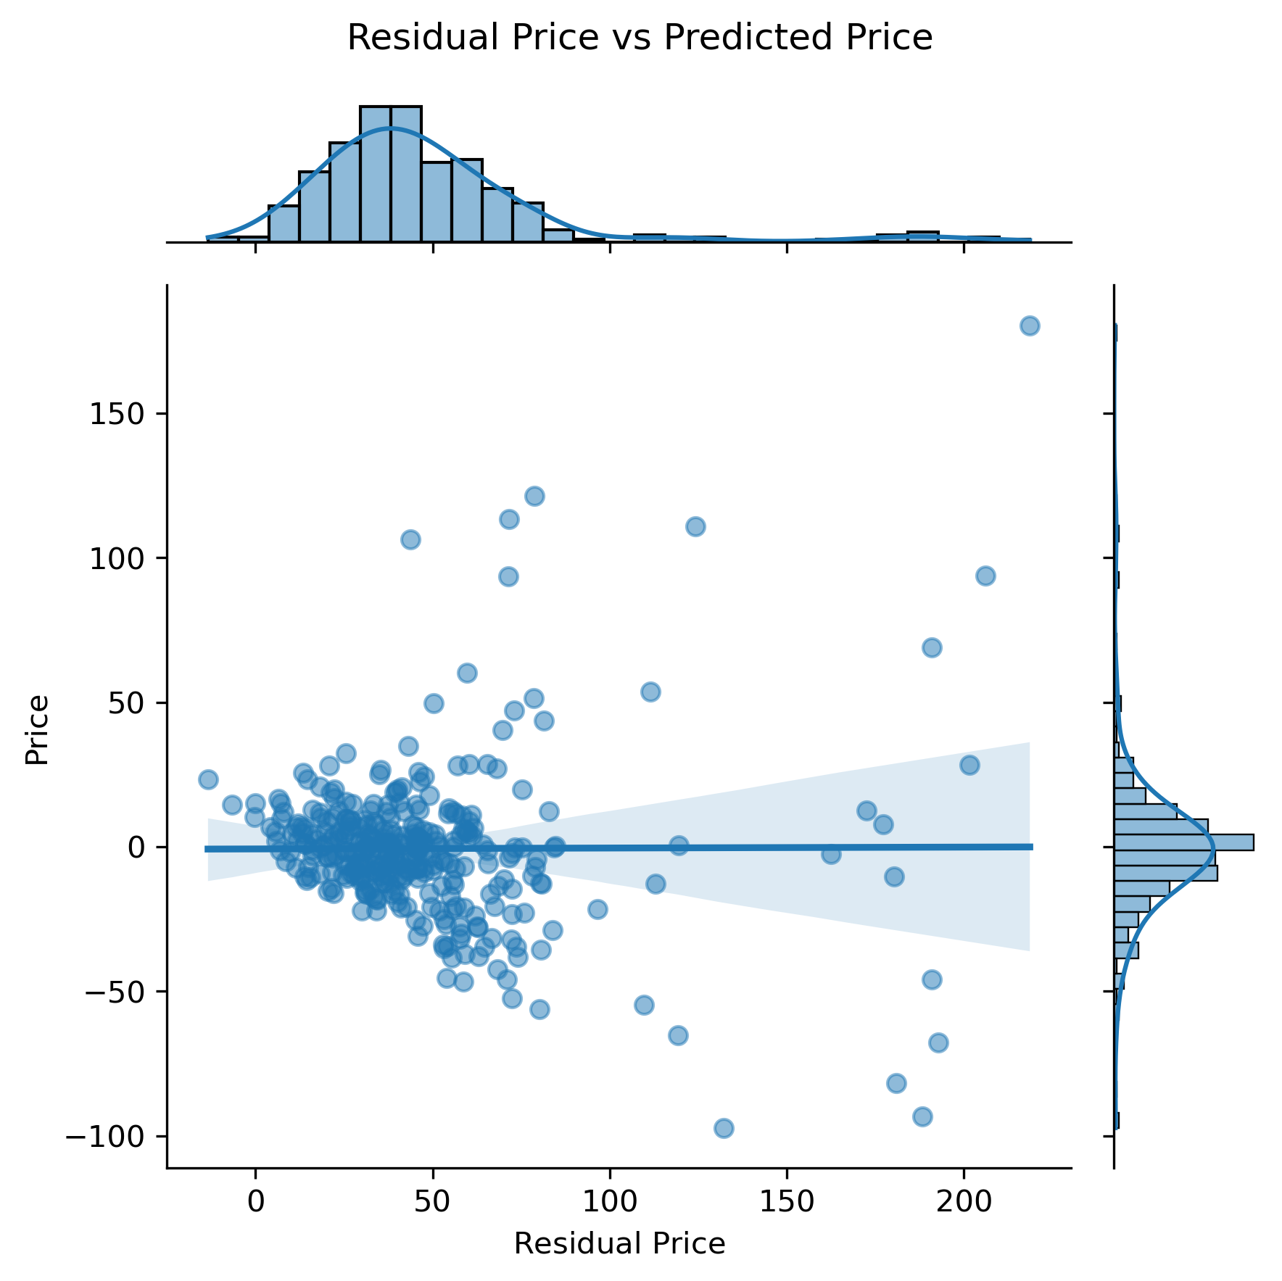
Lasso Regression

Slide 7
R^2 Values of Regression Models
Train/Validation/Test | R² | Mean Absolute Error | Cross Validation/Test | R²
Linear Regression | 0.6362 | 16.3508 | Linear Regression | 0.6024
Ridge Regression | 0.6362 | 16.3413 | Ridge Regression | 0.6030
Lasso Regularization | 0.6363 | 16.3398 | Lasso Regularization | 0.6024
Polynomial Regression | 0.6362 | 16.2660 | Polynomial Regression | 0.6020

Slide 8
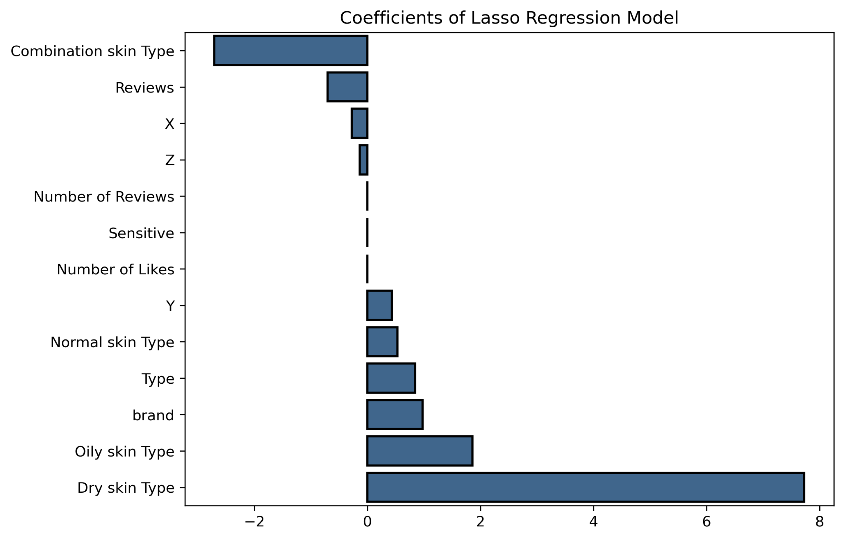
Features Affecting Price
Notes:
Variables x y and z use Tsne (t-distributed stochastic neighborhood embedding: Converts similarities between data points to joint probabilities and tries to minimize the divergence between joint probabilities
Attempt to visualize several features into 2-3 dimensions

Slide 9
Conclusion
Used Random Forest Regression because of Mean Absolute Error
Price range of most skincare products: ~$15.00 to ~$100.00

Slide 10
Future Work
Gathering skin care product information from other websites such as Ulta, OliveYoung, YesStyle, etc.
Getting more numerical features and clinical data
Comparison between top products, skincare vs makeup products
Ordinal encoding of ingredients as well

Slide 11
Appendix
1000+ data points on skincare products:
Toner
Cleansers
Facial Cream
Facial Sheet masks
Sunscreen
Cushions
Data cleaning: Products with no reviews will be considered as 5 stars so as not to assume they are bad products
Reasons for selecting products:
Used in skincare steps
Skin suitability based on types:Normal, Oily, Combination, Sensitive
Makeup as a daily skincare product as well
Ingredients:
Retinol, Ascorbic Acid, Niacinamide, Ceramide, Squalane, Hyaluronic Acid, Vitamin E, Titanium Dioxide, Glycolic Acid, Sodium Acetate, Sodium Benzoate, Sodium Hyaluronate, Panthenol

Slide 12
Thank you

